Slide 1
Software development approaches
(views and opinions)
Bjarne Stroustrup
AT&T Labs – Research
http://www.research.att.com/~bs

Slide 2
My perspective
Researcher
  Research manager
  Programmer/designer
  Teacher
  Consultant (not on a fee basis)
C/C++ community
Unix/Windows
Systems programming / embedded systems
Not primarily
  IT
  Production
  Applications

Slide 3
Overview
Generalities
Tool chains
  Project-focused discussion
Programming techniques
  C++ based (that’s what I know best)
Standards
  Everybody got a few
So what can we do to make progress?
  (provocative horror show – it’s Halloween)

Slide 4
Generalities
Our civilization runs on computers
  More and more of a computer is software
  More and more of our environment contain computers
  We need
    More software
    Built in less time
    More reliable
    With more “features”
  “High tech” v.s. “Cheap labor”
    Curious trends: lots of “tech” with expensive labor
Because software is crucial, money talks (shouts!)
  Makes it hard to make technical decisions

Slide 5
Communities
The software development community has fractured
  Web designers
  VB programmers
  Analysts/designers
  Traditional skilled programmers
  C/free-software hackers
  Academic FP-community
  Licensed company X internals specialists
  …
These groups don’t understand each other’s languages, tools, and work methods
  Each group has sub-groups who don’t understand each other’s languages, tools, and work methods
    E.g. C, C++, Java, Ada
  This is not just specialization
    Tower of Babel

Slide 6
Modularity and communication
“separating things are easy”
  It’s having separate entities communicate that’s hard
Have “reuse” succeeded or failed?
  Certainly the hype was wrong (surprise!)
  Huge components
    Compilers, operating systems, communications packages
  Tiny components
    subroutines
  Medium-sized components
    This is where it gets interesting/difficult
    Plug-ins, some CORBA objects, some COM components, libraries

Slide 7
Buzzwords
“Objects”
  are not everything (I promised you that they wouldn’t be ☺)
  Are useful in their proper roles
IDLs (Interface Definition Languages)
  Try to become systems development platforms
    Data definitions, actions, …
    Language independence
      reduces expressiveness, has binding costs
      A language independent language is an oxymoron
Integrated development environments
  Monoliths, proprietary, try to do everything for everybody

Slide 8
Tool chains
I love ascii! (unicode is also ok)
  Human readable and writeable
  Key to modularity
  Hard to make proprietary
Examples
  Unix intermediary formats
  HTML
  XML
  Postscript
  Source code

Slide 9
A common, simple, problem
A third
module
Another
module
One
module
Simple distributed computing
  No shared memory
  No real master
  Some communication asynchronous
  Sometimes communications fail
  Sometimes modules fail

Slide 10
A common, simple, problem
Pick a module/communication system
  CORBA, COM, .net, Java, …
Now, have you chosen?
  Programming language
  Vendor
  Performance limits
  Database system
  Development platform
  Hardware supplier
  Education for your developers
  Culture
  …

Slide 11
XTI/XPR
Related problems
  Programming distributed systems
    Marshalling/unmarshalling
    Multitude of IDL “standards”
    Poor C++ bindings
  Serialization
  XML reading/writing
  Program manipulation

Slide 12
Distributed programming in ISO C++
// use local object:
X x;
A a;
std::string s("abc");
// …
x.f(a, s);
// use remote object :
remote_proxy<X> x;
x.connect("my_host");
A a;
std::string s("abc");
// …
x.f(a, s);
“as similar as possible to non-distributed programming, but no more similar”

Slide 13
Program manipulation: XTI/XPR
C++
compiler
Object code
C++
source
RPC
generator
Symbol table
XPR
generator
XTI
XTI
XPR
IDL
XML

Slide 14
XPR
C++ source
XPR
struct B {
int xx;
};
Char* f(const int *);
template<class T>
struct D : private virtual B,
protected B2 {
int zz;
char* (*f)(int);
list< vector<int> > lst;
};
B : class {
xx : int public
}
f : (:*const int) *char
D : <T> class {
#base : B virtual private
#base : B2 protected
zz : int public
f : *(int) *char public
lst : list<vector<int>> public
}

Slide 15
XPR (eXternal Program Representation)
Easy/fast to parse
Easy/fast to write
Compact
Robust: Read/write without using a symbol table
LR(1), strictly prefix declaration syntax
Human readable
Human writeable
Can represent almost all of C++ directly
  No preprocessor directives
  No multiple declarators in a declaration
  No <, >, >>, or << in template arguments, except in parentheses
Can be thought of as a specialized portable object database
Why not “simply XML”?
  Bootstrapping
  Tool chain

Slide 16
Programming
Programming really is an interesting topic
  techniques
Programming languages do differ
  Syntactic differences are quite uninteresting
    But syntax is the focus on religious wars
  Programmers do only what they can express directly
    Libraries
    Distribution
    Teaching

Slide 17
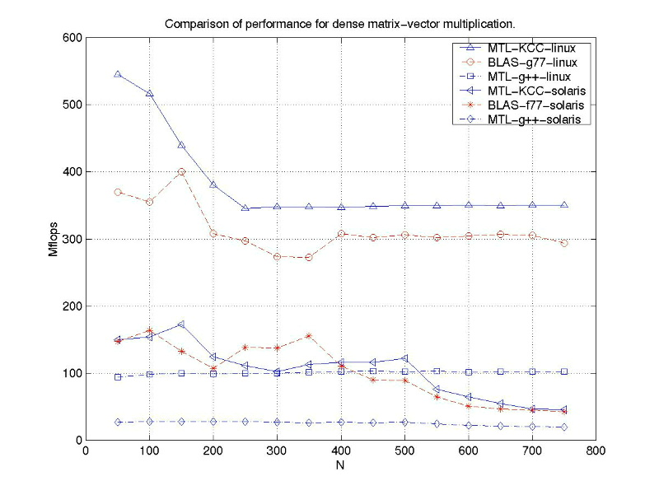
Uncompromising performance

Slide 18
Matrix optimization example
struct MV { // object representing the need to multiply
Matrix* m;
Vector* v;
MV(Matrix& mm, Vector& vv) : m(&mm), v(&vv) { }
};
MV operator*(const Matrix& m, const Vector& v)
{ return MV(m,v); }
MVV operator+(const MV& mv, const Vector& v)
{ return MVV(mv.m,mv.v,v); }
v = m*v2+v3; // operator*(m,v2) -> MV(m,v2)
// operator+(MV(m,v2),v3) -> MVV(m,v2,v3)
// operator=(v,MVV(m,v2,v3)) -> mul_add_and_assign(v,m,v2,v3);

Slide 19
Function Objects
Function objects
  Essential for flexibility
  Efficient
    in practice, more so than inline functions
    important: sort() vs. qsort()
  Some find them tedious to write
    Standard function objects
      e.g., less, plus, mem_fun
    Can be automatically written/generated
      Vector v2 = m*v+k; // matrix and vector libraries
      find_if(b,e, 0<x && x<=max); // lambda libraries

Slide 20
Object-oriented Programming
Hide details of many variants of a concepts behind a common interface
    void draw_all(vector<Shape*>& vs)
    {
    typedef vector<Shape*>::iterator VI;
    for (VI p = vs.begin(); p!=vs.end(), ++p) p->draw();
    }
Provide implementations of these variants as derived classes

Slide 21
Class Hierarchies
One way (often flawed):
class Shape { // define interface and common state
Color c;
Point center;
// …
public:
virtual void draw();
virtual void rotate(double);
// …
};
class Circle : public Shape { /* … */ void rotate(double) { } /* … */ };
class Triangle : public Shape { / * … */ void rotate(double); /* … */ };

Slide 22
Class Hierarchies
Shape
Users
Circle
Triangle

Slide 23
Class Hierarchies
Fundamental advantage: you can manipulate derived classes through the interface provided by a base:
void f(Shape* p)
{
p->rotate(90);
p->draw();
}
You can add new Shapes to a program without changing or recompiling code such as f()

Slide 24
Class Hierarchies
Another way (usually better):
class Shape { // abstract class: interface only
// no representation
public:
virtual void draw() = 0;
virtual void rotate(double) = 0;
virtual Point center() = 0;
// …
};
class Circle : public Shape { Point center; double radius; Color c; /* … */ };
class Triangle : public Shape { Point a, b, c; Color c; / * … */ };

Slide 25
Class Hierarchies
Shape
Users
Circle
Triangle

Slide 26
Class Hierarchies
One way to handle common state:
class Shape { // abstract class: interface only
public:
virtual void draw() = 0;
virtual void rotate(double) = 0;
virtual Point center() = 0;
// …
};
class Common { Color c; /* … */ }; // common state for Shapes
class Circle : public Shape, protected Common{ /* … */ };
class Triangle : public Shape, protected Common { / * … */ };
class Logo: public Shape { /* … */ }; // Common not needed

Slide 27
Class Hierarchies
Shape
Users
Logo
Common
Circle
Triangle

Slide 28
Multiparadigm Programming
The most effective programs often involve combinations of techniques from different “paradigms”
The real aims of good design
  Represent ideas directly
  Represent independent ideas independently in code

Slide 29
Algorithms on containers of polymorphic objects
void draw_all(vector<Shape*>& v) // for vectors
{
for_each(v.begin(), v.end(), mem_fun(&Shape::draw));
}
template<class C> void draw_all(C& c) // for all standard containers
{
for_each(c.begin(), c.end(), mem_fun(&Shape::draw));
}
template<class For> void draw_all(For first, For last) // for all sequences
{
for_each(first, last, mem_fun(&Shape::draw));
}

Slide 30
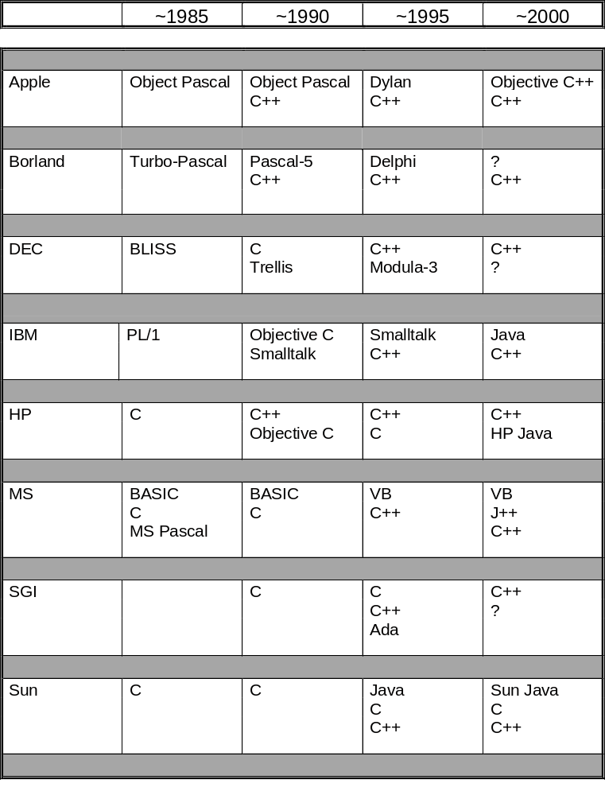
Vintage 1997 slide
Our suppliers prefer us to use their proprietary languages

Slide 31
Standards
Formal standards
  ISO, IEEE
Consortia
  CORBA, W3C
Corporate
  Microsoft, Sun
Users are always underrepresented

Slide 32
What can we do to make progress?
Computer science
  Hasn’t had a Copernicus, a Galileo, a Tycho Brahe, or a Newton
    No accepted basic model of our works
    No accepted standard for what an experiment is
    No accepted standard for measurement
    No predictive integration of experimental results and math
  Hasn’t had a Hippocrates
    No accepted definition of professionalism
As a science or an engineering discipline
  We lack a shared scientific foundation
  We lack a shared base of established practice
  We lack a shared culture (history, heroes)

Slide 33
What can we do to make progress?
Huge gaps between “academic” understanding and industrial practice
  Much effective software development is cottage industry and craft
  “best practices” are often defeated in fair competition
  Marketing dominates
  Non-system builders make crucial technical decisions
    Without acknowledging that the decisions are technical
Huge variation between different groups doing similar projects
  Tools (incl. Languages)
  Techniques
  Sociology (separation of tasks, management style)

Slide 34
What can we do to make progress?
We must measure and classify
  Measure things that are meaningful and useful
  Develop the ability to predict
We must develop tools for measurement
  Performance
  Complexity
  Reliability
  Effectiveness of techniques
  …
Who might be able to do this?
  Academia: no (doesn’t have the right problems)
  Industry: no (doesn’t have the freedom to experiment)
  Industry and academia: maybe
  Genius needed (methodologists cannot be primary)
It’s going to take far longer than we would like

Slide 35
What can we do to make progress?
Actually, I’m mostly an optimist
  Because we are making progress
But I’m less of an optimist than I used to be
  Education
    Better educated people drowned by the half-educated
    Marketing dominance of much education
    Training
    Academic disengagement from real-world problems
  Programming languages
    Much code in “Pidgin-C”
    Much emphasis on the half-educated
  Design
    Still lack of feedback
    Process obsession
  Tools
    Often drown us in incidental complexity
  Science
    I’m still waiting

